Slide 1

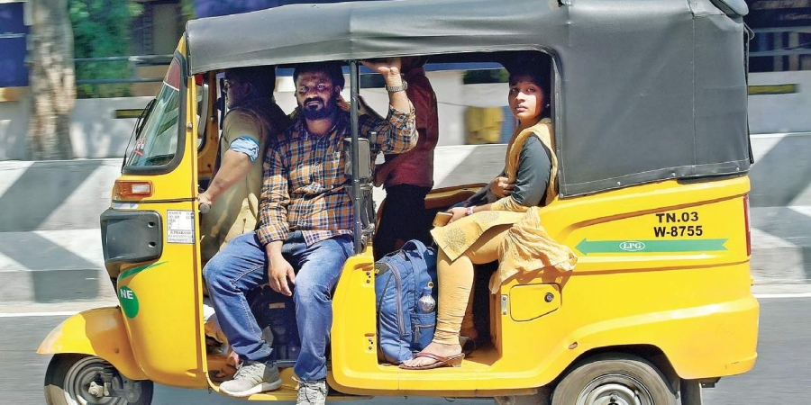
PASSENGER CONTROL IN SMART CITIES USING DEEP LEARNING
Project guide : Assistant professor Mrs . Sheethal M S
Group members : Delna T D
: Dhanya P Pauly
: Dona Johnson
: Jesta Jose

Slide 2
INTRODUCTION
Introducing “Passenger control in smart cities using deep learning ” with increased accuracy in prediction.
System predict the number of passengers in the vehicle and the load.
Detect the number of passenger in the vehicle using deep learning.
Number of passengers beyond a limit is not encouraged to travel in the vehicle.
Proposed system will detect the overload and passenger count then displayed in the system in front of the driver driver.

Slide 3
PROBLEM STATEMENT
Overload in public transport
Accidents due to overload
Health problems
Epidemic conditions

Slide 4
LITERATURE SURVEY

Slide 5
PAPER 1 :Passenger Detection And Counting Inside Vehicles For ecall - A Review On Current Possibilities
Purpose of an eCall system is the
Autonomous detection of car crashes
Subsequent alerting of the emergency services
Thus saving lives or reducing the seriousness of injuries
SEATBELT BASED SOLUTIONS
One possibility to investigate the number of the passengers in cars is seatbelt monitoring.
This approach might not be only usable
To give the exact number of passengers
If accidents happen, additional information can be given
About the state of the belt
Whether the passenger was seated with belt, or not.

Slide 6
IR BASED OPTICAL METHODS
Passenger recognition and counting, using a CCD camera and image processing
Monitoring the passengers and the drivers with CCDs is used more widely nowadays for a variety of purposes including safety but mostly
Due to the rather complex image processing
Suitable accompanying hardware their convenient applicability is limited.
The rapid development of thermopile based infrared array sensors enables a
Cheaper
Simpler possibility to monitor the number of passengers in the compartment.

Slide 7
PAPER 2 :Vehicle Overload Detection System Based On Magneto Resistance Sensor
When the vehicle is overload, the system sends the alarm message to the driver's handheld device and Beidou terminal.
The load detection system is based on the magnetoresistance sensor.
When the vehicle loads, the distance between the axle and frame changes, which is the distance between magneto resistance and permanent magnet.
HMC1052 is used for distance measurement.
The INA126 is precision instrumentation amplifier.

Slide 8
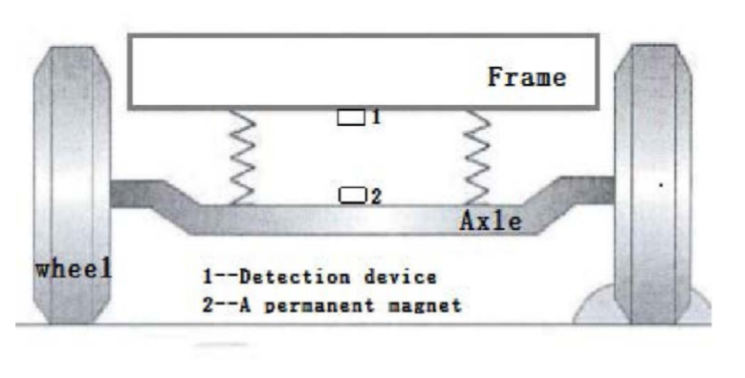
Basic device of sensor is wheat-stone bridge.
ADS7825 is used as the analog digital conversion chip.
If the distance between the both magnitude are more indicate safe condition and if they are near then unsafe condition.
Advantages are
High accuracy
Not easily affected by the complex environment of the vehicle.
The system costs less.

Slide 9
PAPER 3 : Overload Monitoring System for Inland River Ferries
Elaborates an intelligent monitoring system for
Monitoring
Collecting various information of passenger ferry during the operation of the ship.
Combined with sensors, wireless data communication and statistics analysis functions.
The core of the system is a set of passenger ferry counting system.

Slide 10
It can also support by BDS.
Finally, all data will be recorded in the storage, the mobile
network will transmit the data to the shore-based receiver.
The system is small in size and low in cost.
It is suitable for the installation of inland river ferries.
It is easy to operate and easy to install.
The system will make it simple to prevent the overloading in the future.
The system has good expansibility and can be used for
reference in other similar fields of information measurement
and control.

Slide 11
PAPER 4 : Passenger Flow Monitoring Of Elevator Video Based On Computer Vision
Passenger flow monitoring plays an important role in elevator intelligent monitoring and elevator operationstatus analysis.
This study gives one of definitions for elevator passenger flow, and proposes a counting method of the passenger flow in elevator based on the fusion of computer vision techniques.
This experiment calculates the passenger flow in real-time detection by dividing the task into three parts

Slide 12
Which is detecting the door status using the background subtraction method, detecting the current floor with Support Vector Machine (SVM) algorithm and counting passengers by YOLOv3 (You Only Look Once) model.
The results show that the proposed method can accurately measure
passenger flow even when passengers are heavily obscured.
Keywords: Computer vision, Elevator, Passenger flow, YOLOv3

Slide 13
PAPER 5: Overload and Load Centroid Recognition Method Based on Vertical Displacement of Body
This paper proposes a vehicle load and load centroid measurement system based on the machine vision and vertical displacement of the body, which is measured during the driving process.
Description of system
System structure
Vehicle Database

Slide 14
System structure
Utilizes machine vision technology to realize non-contact vehicle motion information capture, and obtain vehicle body characteristic parameters.
Vehicle database
Vehicle identification
Vehicle parameter data
Vehicle characteristic data

Slide 17
PAPER 7 : Passenger Management System Based on Face Recognition for Intelligent Transport Vehicles
In this paper, AdaBoost method utilizing Local Binary Pattern (LBP) histogram is employed for face detection system.
Local Binary Pattern (LBP) was designed to represent the local-texture of the image.
LBP operator is simple and of the low computational complexity.
In this mainly using two algorithm mechanisms that is “Feature Extraction and AdaBoost Learning”and “Cascade Structure for Improve of Detection Time”.

Slide 18
For the AdaBoost learning, we select the best classification sub-block among the candidate feature block in the training data, face and non-face.
After the update of the weight of candidate feature block, we select the next best classification feature block.
After selecting the desired number of weak classifier, the strong classifier is generated by combining selected weak classifiers.
To implement the real-time face detection, we use the cascade structure, Sub-images of input image are fed into the cascade structure.
A series of weak classifiers are applied to every sub-image.
If the sub-image has passed the previous weak classifier, this sub-image is input into the next weak classifier,

Slide 19
PAPER 8 : Passenger vehicle counting method of hov/hot system
In this paper, its is done by refined image acquisition scheme and novel number of passenger counting algorithm are proposed.
Automated number of passenger in vehicle counting system has been desired to realize for HOV (High Occupancy Vehicle) and HOT (High Occupancy Toll) use.
Exhaust gas from vehicles occupies the large part of the cause of these issues, schemes of HOV and HOT have been administered in the United States and other countries.
The proposed system is composed of four main equipment: floodlights, cameras, a laser sensor, and processing unit .

Slide 20
Floodlight :To count the number of passengers through these glasses, the proposed system adopted large intensity floodlight.
its of the wavelength of 730nm is used because of low risk of eye
Camera : Corresponding to the wavelength of floodlight, effective wavelength range of adopted camera covers from 300nm to 900nm. Image resolution is 1920x1080 and image angle is fixed so as to make face region size more than 50 pixels on the image.
Laser Sensor :This sensor is used to generate the trigger signal for floodlight illuminating, image capturing and image processing. The maximum reachable distance is 80m and its operation frequency is 100 Hz.
Processing Unit :The processing unit is installed either in an outdoor enclosure or in a server room. Hardware specification such as CPU with 6 cores of 3.4GHz

Slide 21
PAPER 9:Automatic passenger counting system using image color processing based on skin color detection approach
In this paper, number of people entering and leaving the bus is an important parameter to allocate the correct number of buses for each public transport service connection line.
In general, most of the available passenger counting system consists of sensor and counter to count the number of passengers on the public transport.
The problem faced by this system is inaccurate counting due to fault in the transmission of data from sensor to counter.
In this paper, there are several image processing techniques will be applied in order to obtain the segmented area of interest of passenger images, as well as to obtain the number of passenger in the bus.

Slide 22
Data Acquisition :For testing the capability of the proposed image processing steps, the images were captured normal, minimal and high lighting conditions, as well as different numbers of passengers on board.
Skin Color Detection based on HSV Color Model:The process of segmenting the area of interest in passenger images require detection of skin color region in the captured images.
Segmentation of Passenger using thresholding Technique: its
manual thresholding technique is utilized in order to perform
to selections of hue and saturation threshold values for segment.
Passenger Counting: Implication of recognition processes start with identification of segmented area of interest by using the bounding box.

Slide 24
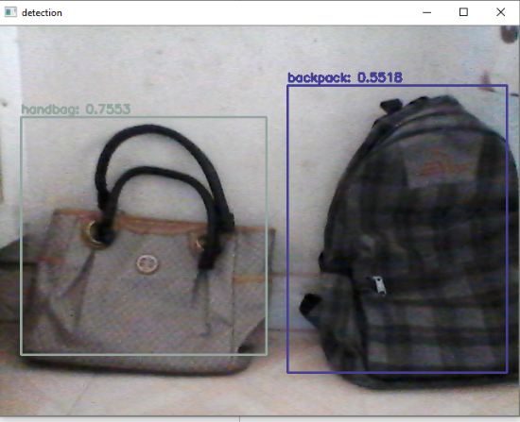
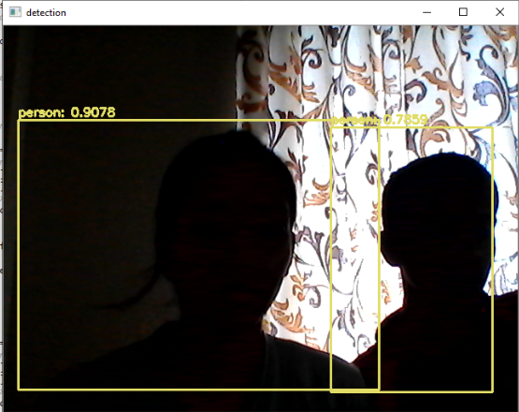
PROPOSED SYSTEM
Detection of passenger overload in taxies.
Setting the limit for passengers according to capacity of the vehicle.
Detect the back bag, luggage and school bag.
Comparing with limit of vehicle.
Real time implementation.

Slide 25
System architecture
OVERLOAD DETECTION
CAMERA
PREPROCESS
SEGMENTATION
DATA ANALYSING
DETECTION
CLASSIFICATION DNN
OVERLOAD DETECTION & DISPLAY

Slide 26
Module description
CAMERA
To take the real time video inside the vehicle.
PREPROCESS
Noise calculation : Sense to supress the noise on preprocessing data. Noise to be reduced to avoid complexity in problems.
Grayscale conversion : conversion of colour image into grayscale image. It reducing a lot of information which are not required and also will save lot of computational power as well.
Threshold : Threshold image analysis technique is a type of image segmentation that isolates objects by converting grayscale images into binary images.

Slide 27
Module description
Canny :The Canny edge detector is an edge detection operator that uses a multi-stage algorithm to detect a wide range of edges in images
SEGMENTATION
Segmentation is the process of partitioning a digital image into multiple segments. The goal of segmentation is to simplify OR change the representation into something that is more meaningful and easier to analyze.

Slide 28
Module description
Contouring :Contours can be explained simply as a curve joining all the continuous points , having same color or intensity. The contouring is a useful tool for shape analysis , object detection and recognition.
CLASSIFICATION DNN
Classifies the images into person ,handbag and suitcase using Deep Neural Network.
DETECTION & DISPLAY
Number of passengers detected then average weight is detected and displayed on the screen.
DATA ANALYSING
Data analysis is a process for obtaining raw data and converting it into information useful for decision-making by users.

Slide 29
Hardware
CAMERA
A camera is an optical instrument used to record images. cameras are sealed boxes with small hole that let light in to capture an image on a light-sensitive surface.
Here camera capture the image that to be used to count the number of passengers occupied in the vehicle.
SYSTEM
A system with WINDOWS 10.

Slide 30
Software
Windows 10
Windows 10 is a computer operating system by Microsoft as part of it’s windows family of operating systems.
Windows 10 is designed to provide a common, “universal“ user interface between desktop, laptop and all in one PCs, tablet computers, smartphones .
Improved compatibility and speed in browsing.
App store is available .

Slide 31
Software
Python
Python is an interpreted high-level programming language for general-purpose programming.
Python has a design philosophy that emphasizes code readability, notably using significant white space.
Python is an open source language.
Google Colab
Google Colab is a free cloud service.
Improve Python programming language coding skills.
Develop deep learning applications using popular libraries such as Keras, TensorFlow, PyTorch, and OpenCV.

Slide 32
Software
YOLO
Real-Time Object Detection. You only look once (YOLO) is a state-of-the-art, real-time object detection system.
YOLO is a clever neural network for doing object detection in real-time.
YOLO is a convolutional neural network based model that detects objects in real time using the "You Only Look Once" framework.
Anaconda 3
Anaconda is a free and open-source distribution of the Python and R programming languages for scientific computing.
Spyder, the Scientific Python Development Environment, is a free integrated development environment (IDE) that is included with Anaconda.
That aims to simplify package management and deployment.

Slide 33
software
Open CV
OpenCV ( Open source computer vision) is a library of programming functions mainly aimed at real-time computer vision.
OpenCV is an open source computer vision and machine learning software library.
OpenCV was built to provide a common infrastructure for computer vision applications and to accelerate the use of machine perception in the commercial products.

Slide 34

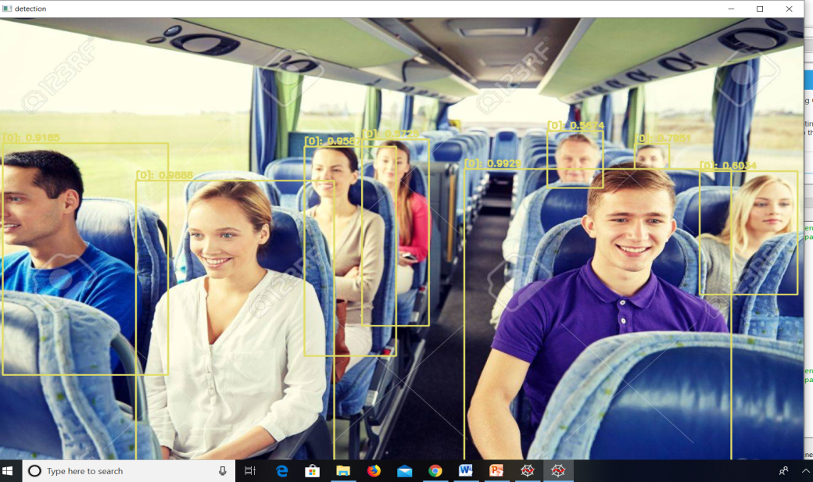

IMPLEMENTATION
Anaconda installed
Training and testing of passenger completed

Slide 35
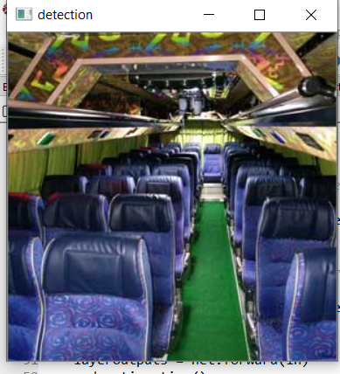
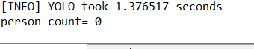
IMPLEMENTATION

Slide 36

IMPLEMENTATION
Person and luggage is trained
Converted to real time.

Slide 37
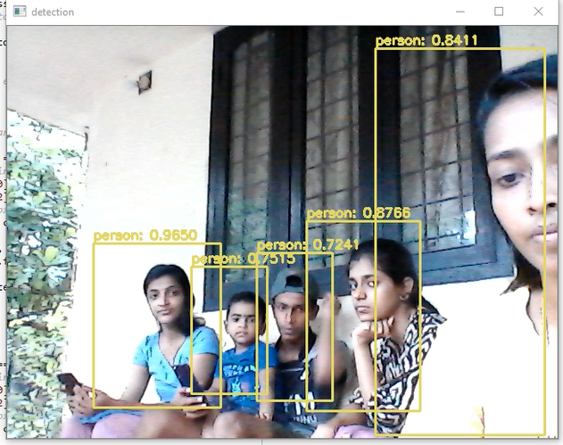
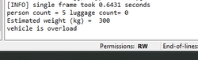

Slide 38
FUTURE SCOPE
Dataset can be further extended to create a better generalization ability.
Accuracy can be increased by predicting age of passengers .
System can be extended by determining whether all vehicles are hygiene or not.
Can be used to predict the rush time in supermarkets.

Slide 39
CONCLUSION
System provide the detection of passenger overload in taxies.
The system is introducing and a deep learning approach to find the overload in vehicle.
Acquire the real time video using camera and system detect and analyze overload using deep learning mechanism using camera.
Considering the luggage that is taken along with the passenger and an average weight is given for the load.

Slide 40
CONCLUSION
Combined with the number of passenger and system will predict whether the vehicle is overload or not.
Predicted the overload inside the vehicle .

Slide 41
REFERENCES
1] A. S. A. Nasir, N. K. A. Gharib and H. Jaafar, "Automatic Passenger Counting System Using Image Processing Based on Skin Colour Detection Approach," 2018 International Conference on Computational Approach in Smart Systems Design and Applications (ICASSDA), Kuching, 2018, pp. 1-8, doi: 10.1109/ICASSDA.2018.8477628.
[2] Q. Fan, "Overload Monitoring System for Inland River Ferries," 2019 5th International Conference on Transportation Information and Safety (ICTIS), Liverpool, United Kingdom, 2019, pp. 1487-1490, doi: 10.1109/ICTIS.2019.8883679.
[3] Z. He, Y. Chen, L. Sun, J. Zhong and Y. Zhu, "Identifying Station-Link Correlation for Target Passenger Flow Control in Subway Network," 2018 21st International Conference on Intelligent Transportation Systems (ITSC), Maui, HI, 2018, pp. 84-89, doi: 10.1109/ITSC.2018.8569533.
[4] Z. Sheng, K. Tian, Q. Tian and H. Qu, "A Faster R-CNN Based HighNormalization Sample Calibration Method for Dense Subway Passenger Flow Detection," 2018 11th International Congress on Image and Signal Processing, BioMedical Engineering and Informatics (CISP-BMEI), Beijing, China, 2018, pp. 1-5, doi: 10.1109/CISP-BMEI.2018.8633050.

Slide 42
REFERENCES
[5] Y. Ding, D. Zhou, Z. Wang, H. Wang, M. Li and S. Yu, "Overload and Load Centroid Recognition Method Based on Vertical Displacement of Body," 2019 34rd Youth Academic Annual Conference of Chinese Association of Automation (YAC), Jinzhou, China, 2019, pp. 479-484, doi: 10.1109/YAC.2019.8787717.
[6] S. Miyamoto, "Passenger in vehicle counting method of HOV/HOT system," 2018 24th International Conference on Pattern Recognition (ICPR), Beijing, 2018, pp. 1536-1541, doi: 10.1109/ICPR.2018.8545415.
7] J. Zhao and G. Yan, "Passenger Flow Monitoring of Elevator Video Based on Computer Vision," 2019 Chinese Control And Decision Conference (CCDC), Nanchang, China, 2019, pp. 2089-2094, doi: 10.1109/CCDC.2019.8833248. [8] N.

Slide 43
THANK YOU

